Slide 1





</coding>
Steve Blanks
Programme Lead
Institute of Coding / University of Sunderland

Slide 2




Growing the UK’s digital talent!
High demand for digital skills
Not going to happen overnight
Break down barriers to digital learning and employment
Partnerships across business, educators and outreach
Provide different ways to access digital education
Design events, courses and training that suit the lifestyles of learners
</Industry Partners>
</Education Partners>
</Outreach Partners>

Slide 3

Theme 1
Enhancing digital employability skills of students and others within universities

Slide 4




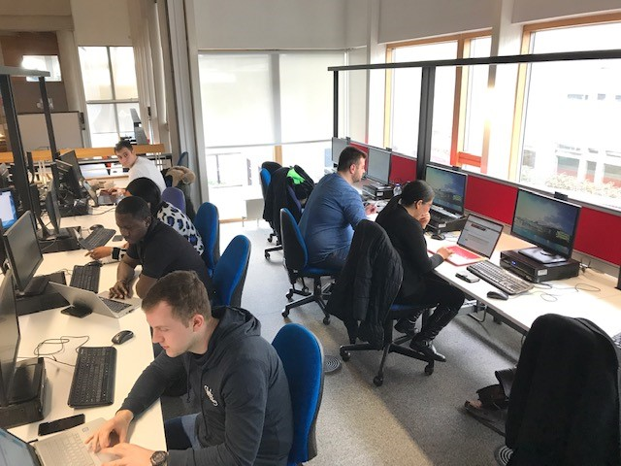
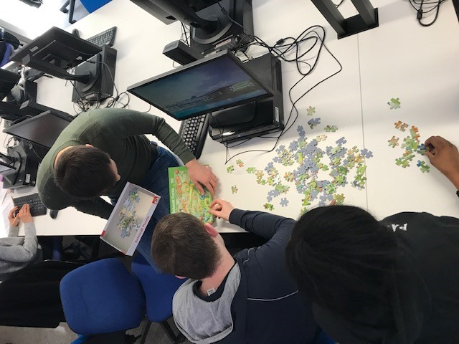
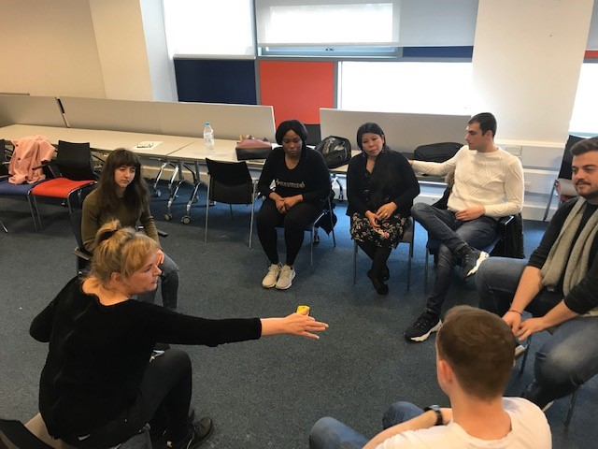
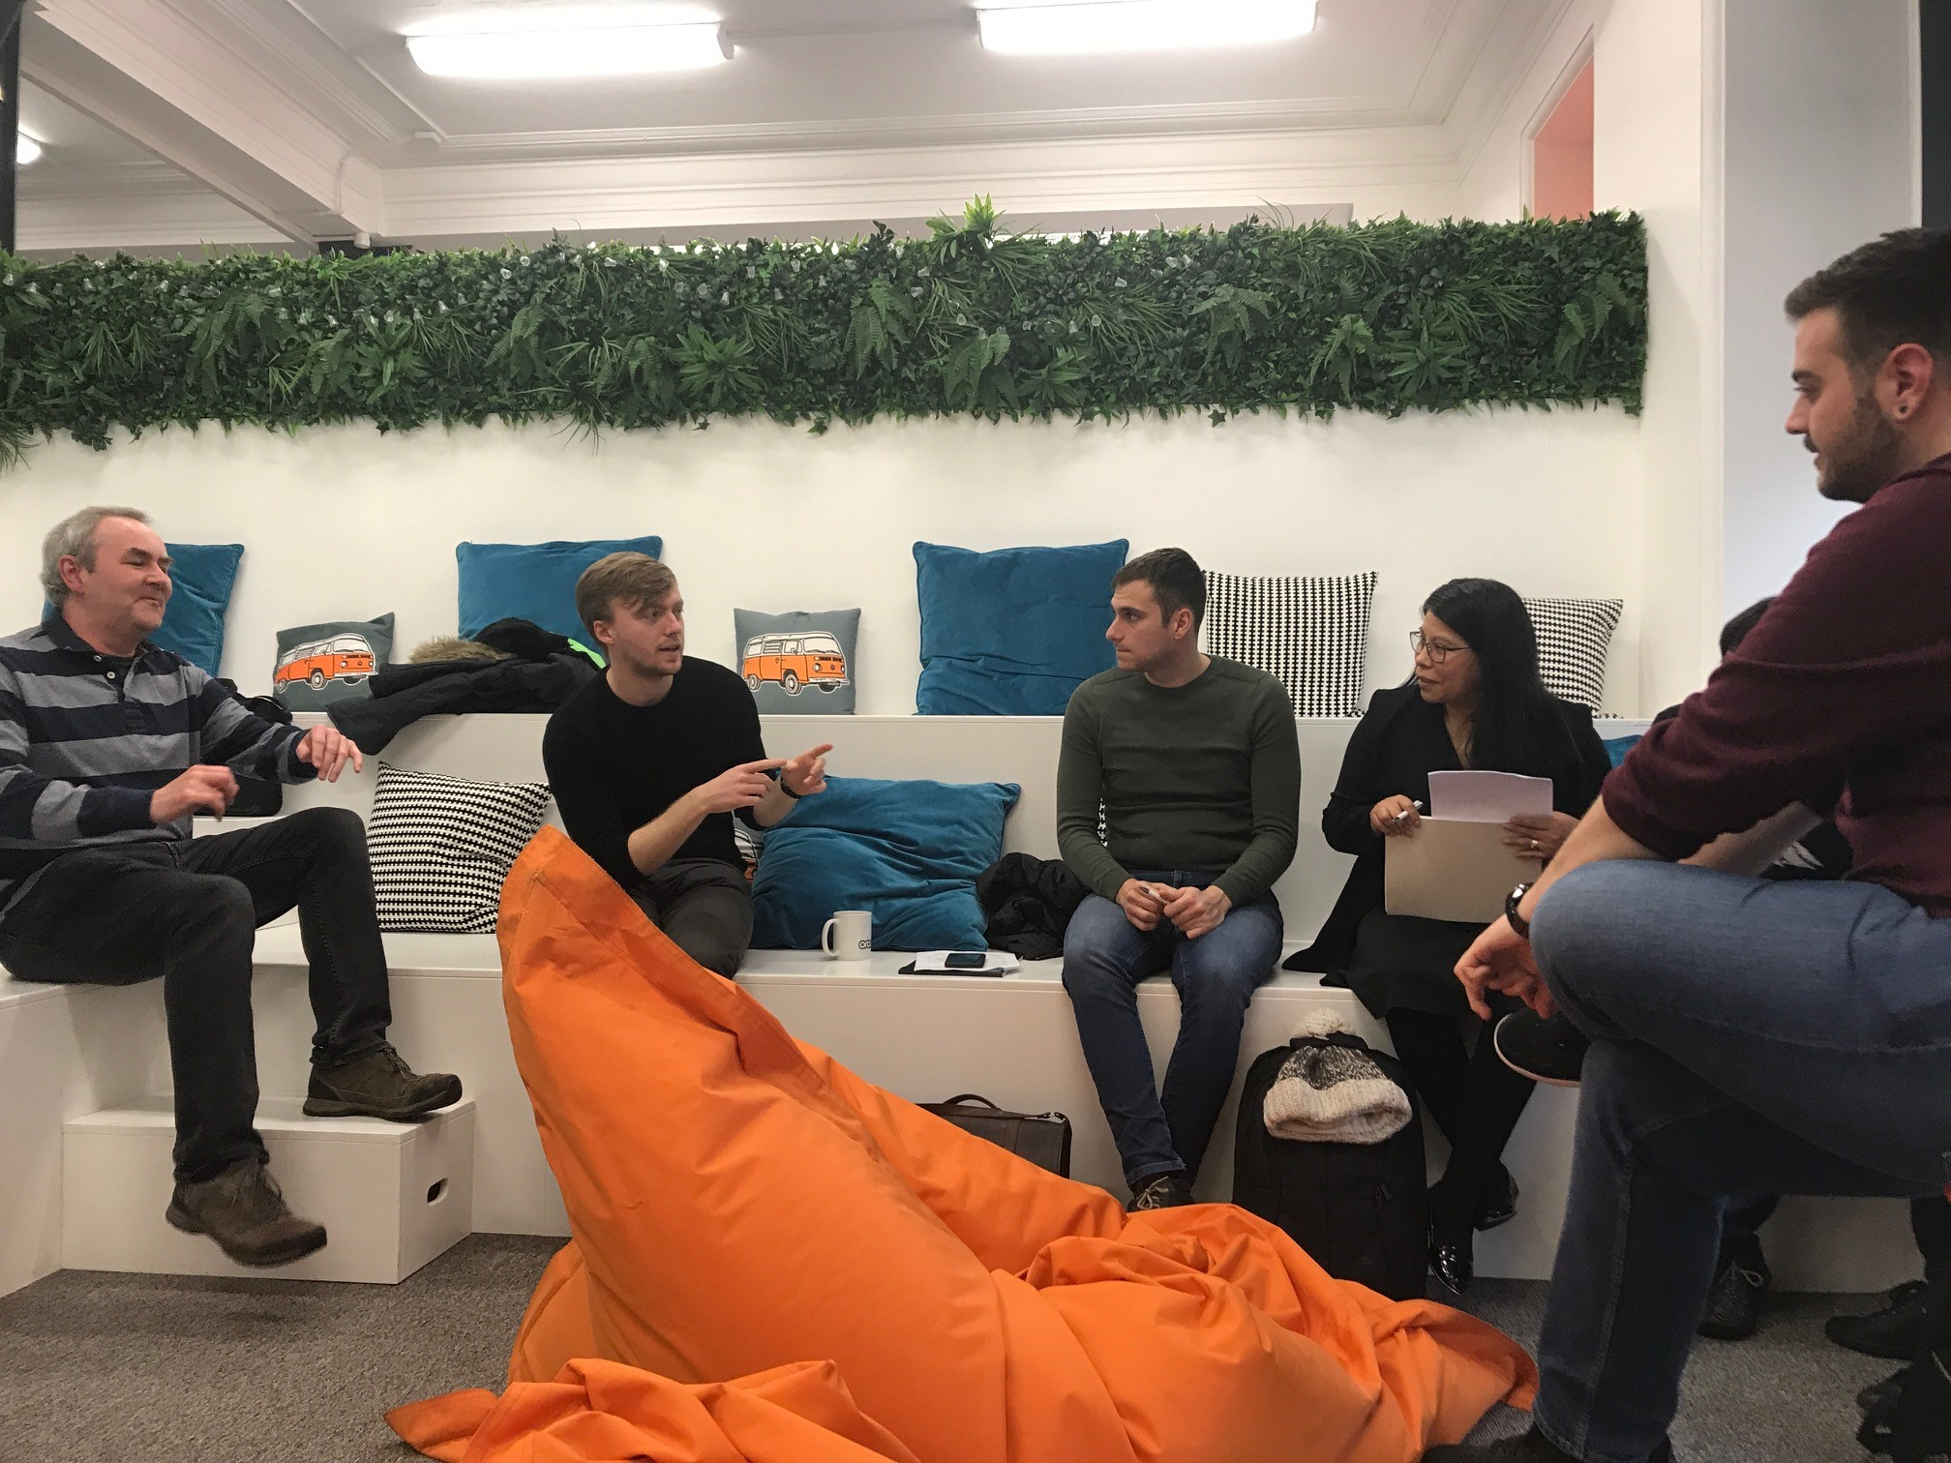


THEME 1: Extra Curricular Innovation
Digital
Technical skills baseline assessment
Commercial Project
Team working, project management and commercials
Presentation and communication
One day sprint project
Interviews with local companies

Slide 5



THEME 1: Curricular Innovation
Software Enterprise Module
Level 5 and 6
Expanding range of industry projects contextualised to topics / courses
Partnerships with digital networks and industry recruiters to build continuous industry project pipeline
Close alignment to industry processes, tools and best practice
Enhancing technical and soft skills of over 100 – 150 students

Slide 6
</coding>

Slide 7

Theme 2
Enhancing digital skills provision for those in work and in computing specialist disciplines

Slide 8


THEME 2: Alternative Delivery Models
Level 7 DTS (specialist in Software Engineering)
Combining industry relevant specialist software engineering and leadership skills
Working with a number of large companies to co-design course
Industry workshops planned to further inform and validate course content

Slide 9

Theme: 3
Digital skills provision for those in professions and sectors not traditionally associated with computing but which are becoming increasingly digital i.e. legal, healthcare

Slide 10


THEME 3: Work Packages 3.2: Short Tasters and Courses
Short Courses
Focus on transport and the automotive / advanced manufacturing sectors
Engaging with a number of industry partners to deliver short courses in Cyber Security, AI, database, IoT and VR
Coding for non coders
Expanding short courses to upskill non digital workers in baseline coding skills
Working with different sectors to understand requirements and plan courses
Workshop with businesses in early June

Slide 11

Theme: 4
Addressing diversity and outreach challenge, e.g increasing number of women in digital related roles and building next generation pipeline

Slide 12
THEME 4: Creating a pipeline
Young People into Computing
Summer bootcamp in partnership with Accenture, with young people (15yrs – 17yrs)
Building pipeline of future learners
Workshops: Women into MSc
Workshops (Qtr 2-3 2019)
Encouraging women to take up ‘top up’ masters

Slide 13
</coding>

Slide 14
Skills gap

Slide 15
Skills gap

Slide 16

Next Steps

Slide 17

Next Steps

Slide 18
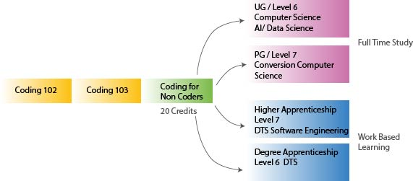
Pathways

Slide 19

Your feedback
Steve.blanks@Sunderland.ac.uk

